Slide 1


IMPROVEMENT
CONTINUOUS
TOOLKIT

Slide 2
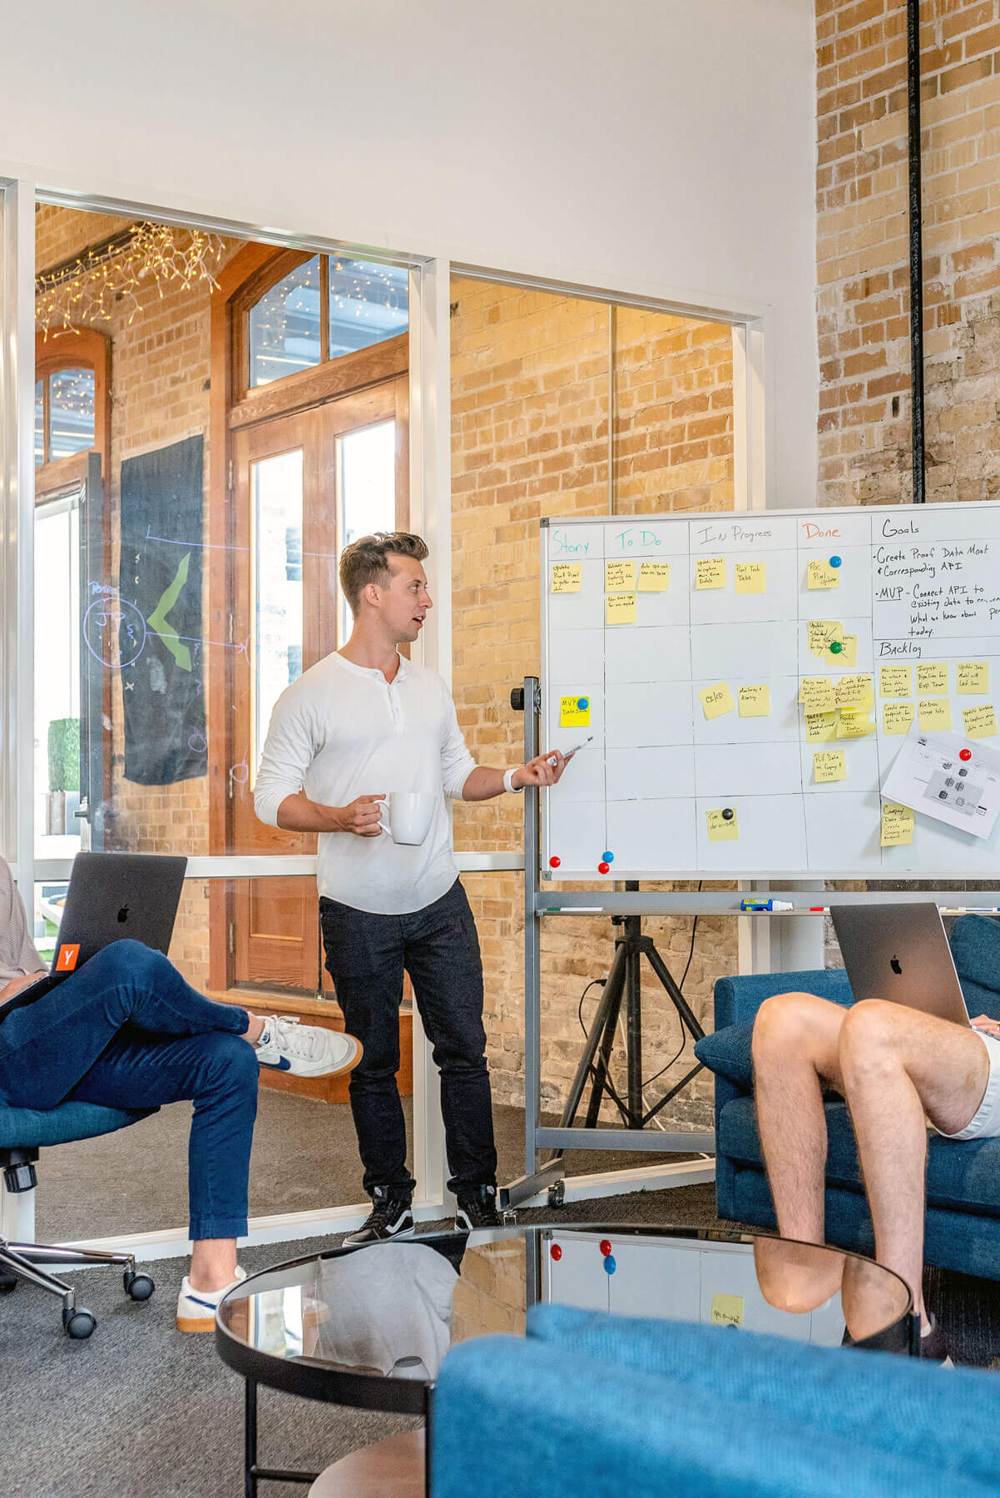

Table of Contents
Introduction
Tools & Templates
Examples
Next steps

Slide 3
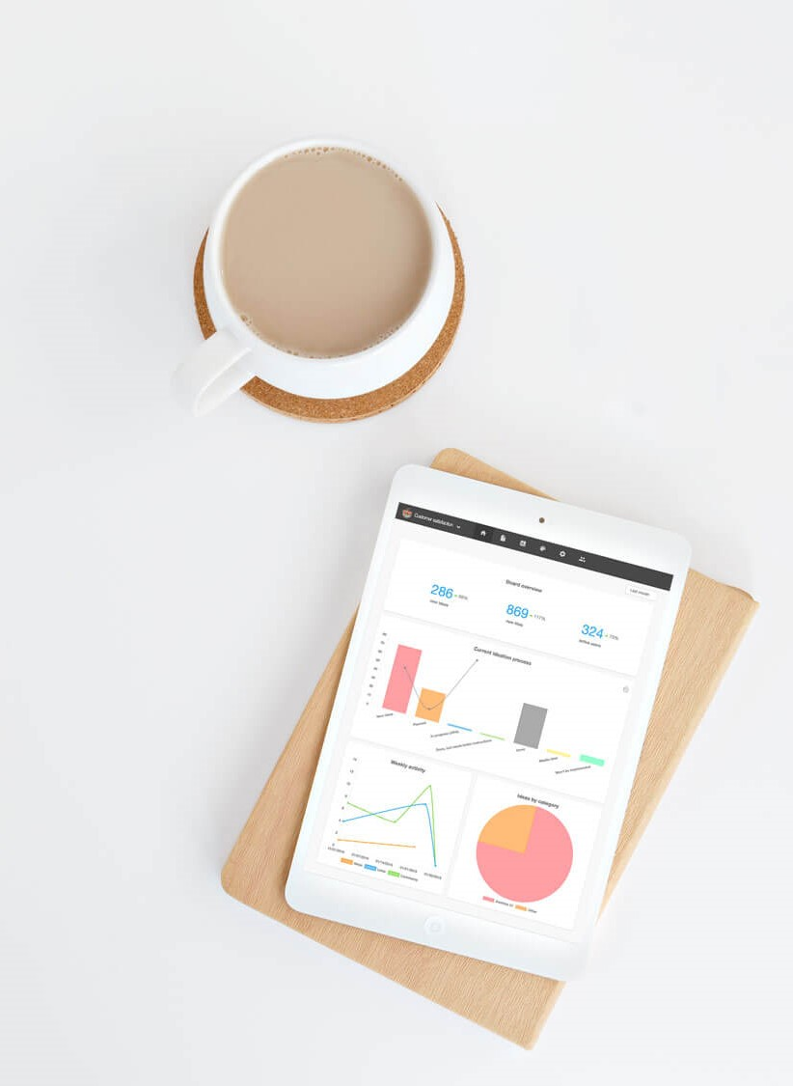
What is this Toolkit for?
If you’re reading this, you probably already know how important continuous improvement is for the long-term success of any company. This toolkit is designed to help you get started with continuous improvement, as well as find ways to improve upon your existing processes.
In this PowerPoint Presentation, we’ll provide you with actionable tools and templates, as well as some examples that can help you grasp the concepts better. You can find more useful information behind the links and in the presentation slide notes.
How to use it?
This presentation will walk you through the key parts, but for a more structured and detailed take on the topic, please read our Ultimate Guide on Continuous Improvement.
You can use the content any way you want, as long as you credit them to Viima. So, feel free to share this Toolkit with your co-workers, or anyone else you’d like to engage in the process.
For more information on innovation management and continuous improvement in general, please refer to our blog.
PLEASE NOTE: This Toolkit is a starting point. Getting results will always take time and effort, so trust the process, be patient, put in the work, and the results will come.

Slide 4
Introduction

Slide 5
As the name says, continuous improvement (CI) is an ongoing process, that should happen:
Every day
Everywhere
By everyone

Slide 6
Cost savings
POTENTIAL BENEFITS
Less waste (time, resources, money)
Increased operational efficiency
Increased customer satisfaction
Improved learning & knowledge sharing
Increased product/service quality
Shorter feedback loop & time to value creation
Notes:
Continuous improvement can lead to many kinds of potential benefits for a company, including:
Hard savings (money, less waste…)
Soft savings (time, quality, customer satisfaction…)
Increased effectiveness in ability to deliver value to customers

Slide 7
Continuous Improvement
leads to compounding
returns over time!
4x industry average
13x baseline
Accelerated pace of innovation
Industry average
Notes:
Let’s take an imaginary company in an imaginary industry.
If the company doesn’t do anything, they won’t get better, which is represented with that gray line.
And, if they don’t get better, they’ll be left behind and inevitably lose market share because their competitors, which the blue line represents will always get better in a capitalistic environment.
That should be pretty obvious, and most people certainly get this.
However, what they don’t understand is how much your pace of innovation, in other words, your rate of continuous improvement matters.
In this imaginary example, the industry will get 0.5% better per week at whatever it is that they do for their customers.
However, if we were to double that rate of improvement to 1% per week, which is for example still much less than the Kaizen target of 1% day, the difference is dramatic.
In just 5 years, this company will be 13x better than the baseline, and almost 4x better than the industry average
That’s because your pace of innovation, your rate of improvement, has compounding returns, which leads to exponential growth, and thus a competitive advantage.
As long as you keep improving at that consistent pace, your competitors can only catch you if they move even faster!
This doesn’t just apply for incremental innovation either, since as we’ve just established, even breakthrough innovations are in reality almost always just a series of slightly smaller innovations bundled together.
So just like it’s been said that compound interest is the most powerful force in the universe, the most powerful force in innovation certainly is the pace of innovation, which is just a fancy way of saying continuous improvement!
It really is as simple as that.

Slide 8
TOOLS & TEMPLATES

Slide 9

Gemba Walk
The Kaizen Cycle
To do a Gemba walk, you go where the real work happens. They are a great tool for managers. Here’s how to run one:
Go meet frontline employees: factory floor, customer service, maintenance…
Go unannounced and don’t plan questions in advance
Observe closely, be curious, ask questions to understand a) what’s going on and b) if employees could fix one (or a few) thing, what would that be, and why
Consider using other inquisitive tools, such as the five whys to truly understand why something happens
The Kaizen Cycle is an iterative process for improving an aspect of your operations, products or services
There are a couple of key points to focus on when using this process:
  Involve everyone in the process
  Test bigger changes at small scale before wider rollout
  Standardize working practices to improve efficiency
  Rinse & Repeat
For succeeding in engaging employees, and to prioritize suggestions, a digital tool such as Viima can be very helpful.

Slide 10
Gemba Walk – your checklist to get started
Start by choosing a topic you will focus on during your walk
This provides a purpose and determines the kind of information you are after and ensures effective results. You don’t have to predefine the challenge, as your focus is to identify possible issues and challenging elements, but it’s important to be aware of the context beforehand.
Plan the walk
Be strategic and proactive in your approach. For this, you need to prepare a set of questions you will ask, as well as a clear structure of the steps you will take, the areas you will visit and the intent for each of those.
Prepare the team
While you don’t have to announce when it will take place, it’s important to inform employees about the Gemba walks, and their purpose. It’s not about testing them, but about learning and improvement. Similarly, if someone will join your walk, train them to know what to observe and what to pay attention to.
Observe the process
The manager’s role is not to show how it’s done. Observe without interrupting people or correcting their behaviour. Your goal is not to intervene, but to simply learn, observe, analyze and take notes.
Gather and analyze data
Once you have gathered all the information you can go back to the drawing board, analyze the findings and identify areas where teams can act.
Work on an action plan
Include the steps to follow, and action required and communicate the findings to the teams. Then start over and prepare for the next Gemba walks to dig deeper or to explore new areas. It’s best to repeat these during different times of the week and of the day.

Slide 11
Plan the walk
Prepare the team
Observe the process
Choose a topic to focus on
Gather and analyze data
Decide on proceeding actions
Gemba Walk – 3 rules
Go see. Observe up close how things are created and whether the reality in the field is aligned with the business objectives and expectations.
Ask why. Try to understand each steps, the ins and outs of the processes.
Act and show respect. Be mindful about the work of employees and show appreciation and genuine interest for what they do. The intention is not to “boss people around”.
The 6 steps of a Gemba walk

Slide 12
Gemba Walk
1. Go and See
Observer:
Participants:
Work area :
Process:
Observation date:
Process analysis
1. What is the standard or process you are working on?
2. What is the purpose of this process?
3. What measures are in place to assess the success of the process?
4. What challenges impact the outputs of the process?
5. Do you have ready access to all the resources necessary for the process?
6. How do you think this process can be improved?
Problem solving
1. What kind of problems are you facing in your daily work?
2. Why is this a challenge?
3. What can we do to implement corrective action?
Continuous Improvement
1. What is today’s priority and why?
2. Is there something you want to improve in your daily routine?
3. Is the information documented and up-to-date?
Notes:
You can add, remove or change questions according to your own environment, project and department
Additional things to observe during the walk:
Who is responsible for the process?
Was the production target met? If not, why?
Do workers appear to be making unnecessary movements in their work?
Are there any machine breakdowns?
Are people following standards?
Are standards up to date?
Are standards present?
Are materials available?
Are processes documented?
Are there any abnormal conditions?
Is the process achieving its purpose and, if not, in what ways is it failing?
What are potential causes of failures?
Is there presence of defective products?
Was corrective action put in place?
Improvement questions/tasks assignments?

Slide 13
Root cause analysis: 5 Whys
Gemba Walk
2. Ask Why
Define the problem:
Root cause problem:
What is happening? What is causing it?
Why is that?
1. (Symptom)
Why is that?
2. (Symptom)
3. (Symptom)
Why is that?
4. (Symptom)
Why is that?
5. (Symptom)
Notes:
Most problems are usually only a symptom of a larger, underlying issue, known as a root cause
The Five Whys is a great framework for finding these real root causes
You’ll find an example above, along with a table that can be used for documenting your problems
Using a systematic method, such as the table mentioned above for documenting these pathways, can help you identify repeating patterns in your processes that cause many issues and should be fixed as soon as possible

Slide 14
Root cause analysis: 5 Whys – The tree framework
If there is more than one pathway and you identify more than one root cause, you can group several root causes under the tree framework.
Define the problem
Contributing factors #1
Contributing factors #2
Contributing factors #3

Slide 15
Root cause analysis: The fishbone diagram
Project:
Date:
Systems
Equipment/Supplies
Environment
The problem / Outcome
Staff/People
Rules(Policies/Procedures
Place

Slide 16
Value Stream Mapping
The value stream mapping (VSM) has four major steps meant to help you identify areas of improvement.
Map the process
Find and eliminate waste
Map improvements and future process
Implement the new process
Notes:
Identify the problem
Brainstorm and ask questions to identify
inefficiencies.
Choose the team
Get together people with different expertise
to provide a wide variety of skills and perspectives
into possible solutions.
Define the scope
Choose on what area of the project to focus on.
Map your value stream
Map the process on three levels. Visualize the product, information and time flows.
Add project data
Include relevant metrics to help you compare data and get accurate insights on time, quality, and quantity.
Create a timeline
Set a clear timeline to get a better sense of the lead time and cycle time
Analyze the current map
Notice areas that need improvement as you build the current state map.
Design the new map
Start working on the future state map where you include elements for areas that need improvement.
Implement new map
Apply the solutions from the new map to the work process.

Slide 17
The Value Stream Mapping process
1. Identify the problem
2. Choose the team
3. Define the scope
4. Create a timeline
5. Add project data
6. Map your value stream
7. Analyze the current map
8. Design the new map
9. Implement the new map
Notes:
Identify the problem
Brainstorm and ask questions to identify
inefficiencies.
Choose the team
Get together people with different expertise
to provide a wide variety of skills and perspectives
into possible solutions.
Define the scope
Choose on what area of the project to focus on.
Map your value stream
Map the process on three levels. Visualize the product, information and time flows.
Add project data
Include relevant metrics to help you compare data and get accurate insights on time, quality, and quantity.
Create a timeline
Set a clear timeline to get a better sense of the lead time and cycle time
Analyze the current map
Notice areas that need improvement as you build the current state map.
Design the new map
Start working on the future state map where you include elements for areas that need improvement.
Implement new map
Apply the solutions from the new map to the work process.

Slide 18
Value Stream Mapping example
Weekly Delivery Plan
Production
Control
Information flow
Supplier
Customer
Daily order
Market forecast
Weekly schedule
Daily schedule
Milling
Welding
Painting
Assembly and production ´
Product flow
Recycling
Shipping
2 people
3 people
2 people
3 people
CT: 2 min
CT: 1 min
CT: 7 min
CT: 2 min
C/O: 3 hr
C/O: 2 hr
C/O: 4 hrs
C/O: 30 hrs
Time flow
5d
10d
12d
8d
25d
Total lead time: 60 days
2min
4min
7min
3min
Value added time: 16 min
Notes:
A value stream map that runs in circle because the customer demand feeds both the supply and production chain.

Slide 19
SIPOC diagram Example for restaurant food preparation.
Process owner:
KPIs and measurement frequency
Purpose of the process:
Interrelated processes
Suppliers
Inputs
Process
Outputs
Customers
Process breakdown
What are the key outputs?
Who are the recipients?
Notes:
1. Map The Process. Break down the process into up to five high-level activities comprising the business process.
2. Identify The Process Outputs. Include up to five key process benefits.
3. Identify The Customers. Determine the recipients of the process outputs – external or internal.
4. Determine The Process Inputs. Map the key inputs necessary for the process completion.
5. Identify The Suppliers. Determine the suppliers of the inputs required by the process.
Once the diagram is complete, it has to be shared with project leaders and stakeholders for its verification before implementation.
**For more transparency and better collaboration, you can implement something similar in Viima using the custom fields. Sign up for free to learn how you can get started. https://app.viima.com/signup
All users have free access to our extensive knowledge base which helps you get started through illustrated, step by step instructions on how to configure and use the software.

Slide 20
Name:
Team:
Date:
5S Audit Form
SORT Sort out necessary and unnecessary items. The unnecessary items should be removed from the area. | Unnacceptable No evidence shown | Poor Only evident here and there | Good Applied and evident in most areas | Excellent Thoroughly evident and apply everywhere | World Class Always looking for ways to make even more improvements
1. Items/supplies on surfaces have been sorted, separating needed | 1 | 2 | 3 | 4 | 5
2. Items/supplies in bookcases or on shelves have been sorted, separating needed from unneeded | 1 | 2 | 3 | 4 | 5
3. Items in cupboards or drawers, including desk and file drawers, have been sorted, separating needed from unneeded | 1 | 2 | 3 | 4 | 5
4. Items on floors have been sorted, separating needed from unneeded eliminating floor piles and all cords are safely contained. | 1 | 2 | 3 | 4 | 5
5. Needed items have been placed at the closest location to where they are used the most to minimize the waste of motion. | 1 | 2 | 3 | 4 | 5
6. Unnecessary items have been removed from the work area | 1 | 2 | 3 | 4 | 5
7. Work agreements for the above are documented and all staff know where to find the agreements. | 1 | 2 | 3 | 4 | 5
Total score:

Slide 21
Name:
Team:
Date:
5S Audit Form
SET IN ORDER A place for everything and everything in its place so it should be easy to find. | Unnacceptable No evidence shown | Poor Only evident here and there | Good Applied and evident in most areas | Excellent Thoroughly evident and apply everywhere | World Class Always looking for ways to make even more improvements
1. Locations of needed items are labeled and items are in correct locations. | 1 | 2 | 3 | 4 | 5
2. Required quantities for needed items are determined (par levels), including items in desk drawers and in bookshelves. | 1 | 2 | 3 | 4 | 5
3. Locations for movable items are labeled, and items are placed in correct locations (white board/ laminated card/label on wall can be used). | 1 | 2 | 3 | 4 | 5
4. Visual controls and indicators are established including: Posted map of area, including individual room maps. | 1 | 2 | 3 | 4 | 5
5. There is Labeling indicating contents of drawers and cupboards (a new person should be able to locate without assistance). | 1 | 2 | 3 | 4 | 5
Total score:

Slide 22
Name:
Team:
Date:
5S Audit Form
SHINE Keep work area clean and ready to use. Inspect regularly to ensure sort and set in order are maintained. | Unnacceptable No evidence shown | Poor Only evident here and there | Good Applied and evident in most areas | Excellent Thoroughly evident and apply everywhere | World Class Always looking for ways to make even more improvements
1. Work areas and equipment are stocked and organized on a consistent basis according to 5S agreements and schedules. | 1 | 2 | 3 | 4 | 5
2. Members of the work group follow 5S agreements on a daily basis. | 1 | 2 | 3 | 4 | 5
3. Sources and frequency of 5S problems are documented as part of routine work by all staff. | 1 | 2 | 3 | 4 | 5
4. Surfaces are cleaned and clear of dust and debris. | 1 | 2 | 3 | 4 | 5
5. Checklists are utilized to identify ongoing Shine duties and the status of these are up‐to‐date. | 1 | 2 | 3 | 4 | 5
Total score:

Slide 23
Name:
Team:
Date:
5S Audit Form
STANDARDIZE Maintain the first three S’s and have an awareness of improving neatness. | Unnacceptable No evidence shown | Poor Only evident here and there | Good Applied and evident in most areas | Excellent Thoroughly evident and apply everywhere | World Class Always looking for ways to make even more improvements
1. There is a 5S agreement in place and all employees know where it is located. | 1 | 2 | 3 | 4 | 5
2. . Leadership can explain why 5S is important. | 1 | 2 | 3 | 4 | 5
3. All staff can explain the importance of 5S. | 1 | 2 | 3 | 4 | 5
4. There is a standard process for training and orienting new staff to the 5S system | 1 | 2 | 3 | 4 | 5
5. There is a process in place to ensure unnecessary items do not “creep” back into the work area. | 1 | 2 | 3 | 4 | 5
Total score:

Slide 24
Name:
Team:
Date:
5S Audit Form
SUSTAIN The 5S Discipline is embedded so that it becomes a way of life. 5S is no longer an event but routine. | Unnacceptable No evidence shown | Poor Only evident here and there | Good Applied and evident in most areas | Excellent Thoroughly evident and apply everywhere | World Class Always looking for ways to make even more improvements
1. 5S plans and action updates are clearly displayed and current. | 1 | 2 | 3 | 4 | 5
2. . Success stories are displayed and confirmed for improvement. | 1 | 2 | 3 | 4 | 5
3. Staff 5S roles are clearly identified. | 1 | 2 | 3 | 4 | 5
4. Department audits and subsequent improvement plans are displayed and current. | 1 | 2 | 3 | 4 | 5
5. Are work instructions and procedures available in the workplace regularly reviewed/kept up to date? | 1 | 2 | 3 | 4 | 5
6. Are display boards, activity charts, notice boards, etc. up to date and regularly checked? | 1 | 2 | 3 | 4 | 5
Total score:

Slide 25
The PDCA (Deming) Cycle
DO
CHECK
ACT
PLAN
The Deming Cycle is the simplest and most common process for CI
If you don’t know what to do, you can keep it simple and just start using this approach
The key is to just establish WHAT you’re looking to improve, and WHY
Once these are in place, just find ways to identify as many positive improvements as you can, and then implement as many of them as you can, then rinse and repeat!

Slide 26
Involve employees
Identify problems
Create a solution
Test the solution
Repeat the cycle
Analyse the results
Standardi-ze & Adopt
The Kaizen Cycle
The Kaizen Cycle is an iterative process for improving an aspect of your operations, products or services
There are a couple of key points to focus on when using this process:
  Involve everyone in the process
  Test bigger changes at small scale before wider rollout
  Standardize working practices to improve efficiency
  Rinse & Repeat
For succeeding in engaging employees, and to prioritize suggestions, a digital tool such as Viima can be very helpful.

Slide 27

Digital CI Tools
Using a digital CI tool, such as Viima, for running and managing all your CI processes has many benefits, for example:
  Easier to engage more employees in the process
  Ability to collect more ideas, and with richer information (e.g. images, videos, not just text)
  Manage and prioritize ideas more systematically with the help of visual tools
  Minimized amount of manual work
  Increased transparency & communication
  Analytics that tell you how you’re doing, and how you can further improve your process
  Ability to track the results & ROI from your CI activities
Viima is completely free for unlimited users and getting started with CI takes just minutes so give it a try by signing up here!

Slide 28








THEME
AUDIENCE
RESPONSIBILITIES
RESULTS &
REFLECTION
TASKS
Write down which problem or opportunity you’re looking to improve upon, and why.
Write down who you’re looking to engage and via which channels.
Decision makers:
Ideally your theme should be well-aligned with your organization’s strategic goals.
Who are the most relevant people for this theme and who do you motivate them?
Advocates:
(Facilitators/”category owners”)
GOALS
TIME
Organizing team:
Set a (measurable) goal or goals
around your chosen theme
Is this is a campaign or a continuous process? Write down your timeline + important dates.
Who are the people responsible for certain tasks and what are those?
Keep track of your results and make sure ideas are followed-up and implemented
Are they challenging but achievable? Do you have the resources to realize them?
When are you launching? How often do you make decisions on ideas? Arranging events?
Who are fit for the positions? Are tasks aligned with goals + audience?
Stop and reflect. How are things going? Where are the current bottlenecks?
Notes:
This is a tool we call the Viima Board Canvas. We use it to help customers plan the key elements of their ideation process, most of which are centered around continuous improvement.
Use the template to help you plan and communicate a new continuous improvement initiative!
This is especially helpful when you’re setting up your first continuous improvement board in Viima as it helps you make sure you’ve got all the basics covered

Slide 29
EXAMPLES

Slide 30

What You Can Learn from These Examples
The following examples were picked to help you understand the possibilities of continuous improvement, and the impact it can have on your innovation and business activities.
They aren’t so much step-by-step guides, but more for providing you with inspiration, and a more holistic understanding of what CI can actually be used for beyond the obvious applications
We’ve tried to also include links to additional resources you can use to learn more from these cases whenever available

Slide 31

The Toyota Way
Toyota is probably the company most famous for continuous improvement.
The Toyota Way is a set of 14 principles that determine how the company operates, and continuous improvement is central to most of these.
The list includes a lot of principles that every company can learn from adapt immediately, even if the biggest effect comes from combining all of them.
Resources:
Wikipedia
The Toyota Way: 14 Management Principles from the World's Greatest Manufacturer

Slide 32

Cleveland Clinic
One of the most well-known and consistently highest ranked hospitals in the US
They’ve invested a lot in continuous improvement throughout the years and shown how it can be applied to challenging industries such as healthcare where mistakes are costly and humans play a big role in operations (as opposed to production lines, machines etc.)
Cleveland Clinic Improvement Model (CCIM) is the model they use for running these processes, it relies on a holistic and participatory model where absolute focus must be paid to what matters the most
Resources:
CCIM explained
CCIM one-pager

Slide 33

Google Innovation Ecosystem
Google needs no introduction, but from a continuous improvement point-of-view, they are an interesting example because they use CI practices as a central force for driving innovation within their ecosystem by continuously looking for and improving everything related to that ecosystem
They also continuously adapt the organization to match needs
While partly outdated, there is an excellent HBR article explaining the model, which you can find linked below
Resources:
HBR: Reverse Engineering Google’s Innovation Machine

Slide 34

Tesla
Tesla is a hot company that’s without a doubt among the most innovative in the world but what makes them an interesting example is how extreme their focus is on continuous improvement on every level and part of the organization, and how fast they are moving on that front – the company is built to embrace change and always look for even the smallest improvements
They embrace new operating models that allow better CI: e.g. first car manufacturer to embrace OTA software updates, which has allowed CI of capabilities of even older cars after they’ve been sold, without the need to visit a dealer, systematically collect data that helps future software development efforts etc.
They focus relentlessly on improving pace of change or cycle times, introducing changes at an unprecedented pace for the industry, even for products and production lines that are in operation.
  For example, they’ve built most of their operational software systems in house to be able to move faster and improve on internal processes quicker than traditional ERP vendors ever could
Resources:
Analyst takeaway on Tesla CI
Example on pace of change

Slide 35
NEXT STEPS

Slide 36
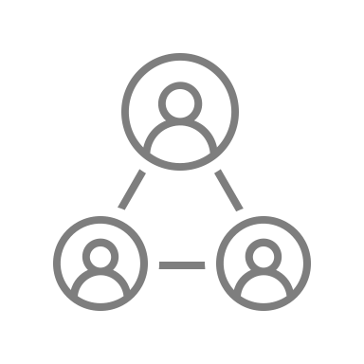



Implement, test, improve
Assess current state
Simple
Strategic
Operational
Chart improvement journey
Map desired outcomes

Slide 37
Developing a continuous improvement plan
Step | Process | Action | Status
Assess current state | Identify the strengths, weaknesses, opportunities and bottlenecks of current processes, products, services, etc. | Workshop Idea collection Kaizen events | Done
Map desired outcomes | Map the business integrated goals and objectives. Notice the gaps between the current state of things and the desired outcome. | Decide the long term objectives and specific goals, timeline and resources | Doing
Chart improvement journey | How you’ll address the gaps through specific actions that contribute to sustained improvements and help develop the culture to enable them. | Define responsibilities Decide the tools, methods of evaluation, and performance metrics | Doing
Implement, test, improve | Engage the workforce at all levels of the organization. All those involved should understand the standards, procedures and best practices for continuous improvement. | Implement improvement activities and processes | Doing

Slide 38

Best Practices to Keep in Mind
1.
Every day, everywhere, by everyone!
2.
Focus relentlessly on your speed of improvement, or cycle times!
3.
Embed CI in the daily processes and job descriptions of most (if not all) employees
4.
Continuously improve your CI process is the key to driving long-term results
Notes:
Whenever you’re looking to use CI to drive more value for your organization, just keep these best practices in mind, and you’ll do well!

Slide 39
ROUTINE
REWARD
CUE
Creating a positive, self-reinforcing feedback loop is the key to making CI stick, and to make a habit of it for every employee!
Source: The Power of Habit: Why We Do What We Do in Life and Business, Duhigg, 2012
Notes:
As discussed, you need to make CI a habit of people across the organization. To succeed in that, you need to create a positive, self-reinforcing feedback loop to make CI stick.
To do that in practice, focus on ensuring that every employee has these three elements present in their daily work!
As an example:
Cue: First, have training that remind employees to keep their eyes open and report anything that isn’t perfect. Then reinforce that training by having cues in the workplace, such as posters on the walls, managers reminding them weekly etc.
Routine: Make it easy to report these findings, for example by having an easy to use and fun software for the purpose. If it’s too hard to do that, or the software is crappy, people won’t keep the routine up.
Reward: Have managers constantly praise and promote everyone who does CI and reports these. Small praise is good for small things, but if someone really hits a home run, make sure everyone knows that.

Slide 40
Setting up a CI Process
Please use this table as a template for creating a concrete plan for setting up (or improving) a process for CI
Task | Goal(s) | Responsible | Status
Choose area to improve and set clear goals | Find strategically important business process or area to improve and have clear goals in place to ensure alignment | Jane Smith | Done
Get budget approved with CFO | Ensure ability to execute improvements | Rebecca Carlson | Doing
Find owners to make decisions and implement ideas in different categories | Ensure decisions are made by people who know the viability of ideas, as well as that they have the resources for implementation | Jane Smith | Doing
Plan the process | Plan a clear process that makes it possible to make educated decisions quickly and transparently | Kathy Carlyle | Doing
Set up tool to match the process | Set up a digital tool to facilitate discussion and manage the entire process | John Doe | Doing
Communicate to employees and facilitate discussion | Launch the process and communicate the what, why and how to employees, facilitate discussion on the digital platform | Jane Smith | To Do
Please note that data in the table is for illustrative purposes, while reflective of the common key actions, you should create your own process in this table with the help of the other tools in this framework.

Slide 41
About Viima
We’re on a mission to help organizations make more innovation happen.
Viima is the all-in-one innovation platform that helps you go from ideas to innovations, every step of the way.
Getting started is fast and easy and the best part is that Viima is completely free for an unlimited number of users!
So, If you’re looking for a tool that can help you run and manage all your continuous improvement processes with ease, you can get started in as little as 5 minutes at viima.com.
START FOR FREE

